Slide 1
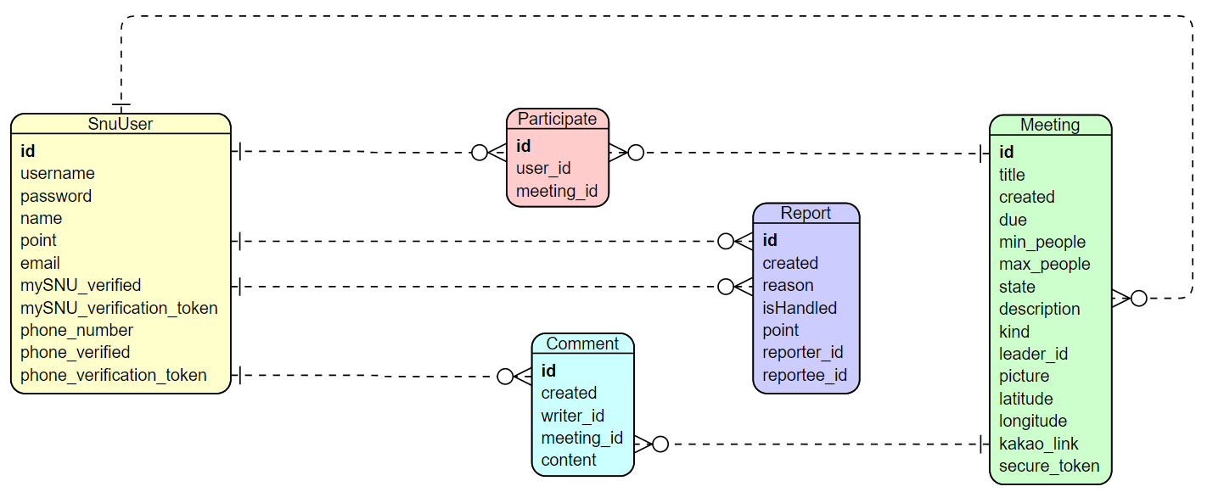
lead
join
recruit
accuse
accused
add
collect

